Slide 1

LOAD FORECASTING USING LSTM
BY:
2020UEE4638 Yash Wardhan
2020UEE4640 Punit Pal
2020UEE4641 Harsh Kalshyan
2020UEE4649 SANDEEP
SUPERVISOR:
Prof. T.N. Shukla
(EE Department)
END TERM REVIEW EEEEC22 B.Tech Project - I

Slide 2
CONTENTS
Introduction
Literature Review
Gap Identified
Objective of the Project
Solution Methodology Adopted
Expected Outcomes
References

Slide 3
INTRODUCTION
Load forecasting is the process of predicting the future electrical demand or load on a power system. It plays a crucial role in energy management, allowing utilities, grid operators, and energy providers to plan and allocate resources effectively.
Load forecasting involves analyzing historical and current data to make predictions about future electricity consumption.
There are different time horizons for load forecasting:
Short-term Load forecasting( for hours only)
Medium-term Load forecasting(for weeks)
Long-term Load forecasting(for annually)

Slide 4
INTRODUCTION
Power generation load forecasting method based on long and short-term memory (LSTM) neural network, which takes the power generation load sequence data as the model input to predict the future short-term power generation load of power generation enterprises
Long Short-Term Memory (LSTM) networks, a subset of recurrent neural networks (RNNs), have emerged as a powerful tool for accurate and dynamic load forecasting.
LSTM unique architecture enables it to capture intricate patterns and dependencies within time series data, making it particularly well-suited for modelling the complex and nonlinear nature of energy consumption.
By leveraging LSTM memory cells and ability to retain information over extended periods, load forecasting models can effectively analyze historical consumption patterns, adapt to seasonality, and account for sudden changes in demand.

Slide 5
LITERATURE REVIEW
Huang et al. (2020) explored the application of hybrid models combining LSTM with other machine learning techniques, achieving even more accurate load forecasts by leveraging the strengths of different algorithms.
Shahzad Muzaffar, Afshin Afsari (2018) conducted the research on medium-term load forecasting for 24 hours, 48 hours, 7 days and 30 days by using the trained LSTM networks and developed models. And the forecasts generated by the LSTM are compared with the results of traditional methods using RMSE and MAPE for all the forecast horizons which shows the LSTM based forecast is better than other methods and have the potential to further improve the accuracies of forecasts.

Slide 6
LITERATURE REVIEW
Zhang et al. (2018) demonstrated the superiority of LSTM models in Medium-term load forecasting when compared to traditional methods, attributing their success to LSTM's capability to capture intricate patterns and adapt to changing load dynamics.
Electrical Load Forecasting Using LSTM Algorithms by Mobarak Abumohsen , Amani Yousef Owda, and Majdi Owda (2023) used the deep learning LSTM algorithm to forecast the electrical load based on the readings taken from SCADA program in electricity company of tubas area of palestine.And the model shows the better accuracy with reduced error percentage in comparison with the other traditional models.

Slide 7
GAP IDENTIFIED
Integrating into LSTM models could enhance accuracy in real-world applications. Addressing these gaps is essential for advancing LSTM-based load forecasting and ensuring its reliability and relevance in diverse energy management scenarios.
Non-stationarity of load data: Load data is constantly changing due to factors such as population growth, technological advancements, and changes in consumer behavior. This makes it difficult to develop load forecasting models that are accurate over time.
The scarcity of studies on medium-term forecasting is a gap in the literature. Our project aims to fill this void through thorough exploration and analysis.

Slide 8
OBJECTIVE
The primary objective is to implement a time series forecasting model for electricity load using Long Short-Term Memory (LSTM) neural networks.
The objective involves developing and implementing an efficient forecasting system that can adapt to the dynamic nature of energy consumption patterns.
Improved accuracy: LSTM networks have been shown to outperform traditional load forecasting methods in terms of accuracy, particularly for short-term forecasts.
Increased adaptability: LSTM networks are more adaptable to changing conditions, such as extreme weather events or changes in consumer behavior.

Slide 9
BLOCK DIAGRAM
Data Pre
Processing
Splitting the data for testing and training
Normalizing the data
LSTM
Model
Splitting the previous training set into a new training set and a validation set
Created 7 days input and output sequence
LSTM Model evaluation on training and validation set

Slide 10
Solution Methodology Adopted
1. Data Pre-processing
Looping all the values to fill the missing values with means of that column.
Summing the energy consumption for each row.
We have dropped all columns other than first and last columns.
“Date” column has been changed from string to date-time format which is useful for time-series analysis.
2. Extracting Features from the Data Columns
Added new columns from date for better time-series analysis.
New “Holiday” column has been added and assigning a value 1 to the corresponding rows where the date matches the specific holiday.
3. Normalizing the data
Standardized the column and calculated the mean standard deviation of TEC(total energy consumption).
(df[columns]-df[columns].mean())/df[column].sty
Performs z-score normalization (how far the data is from the mean)

Slide 11
Solution Methodology Adopted
4. Splitting the data for testing and training
Converted the TEC into ‘float32’ data type
Split the dataset into training and testing based on the year
Training - before 2021
Testing - after 2021
5. Identified the features that should be used (e.g, Tec, day, holiday)
6. Created 7 days input and output sequence
‘X’ and ‘Y’ represents the training
Where ‘X’ represents the input sequence and ‘Y’ represents the output sequence to be predicted.
7. Splitted the previous training set into a new training set and a validation set
X-train -> 80% input sequence
X-val -> 20% validation
Y-train -> output sequence for training set
Y-val -> output sequence for validating set

Slide 12
Solution Methodology Adopted
8. Splitted the static and temporal inputs
Extracted the dimensions of input and output.
Time series and feature inputs for training set.
Extracted time series and feature for validation set.
9. LSTM Model
For Graph - I
Y-axis -> z-score normalisation (-3 to 3)
X-axis -> No. of days in validation set
For Graph - II
Y-axis -> energy consumption
X-axis -> No.of days in validation
To further evaluate the model the predicted value of the model on the validation data was plotted compared to the expected values for the first predicted day and the 7th predicted day.

Slide 13
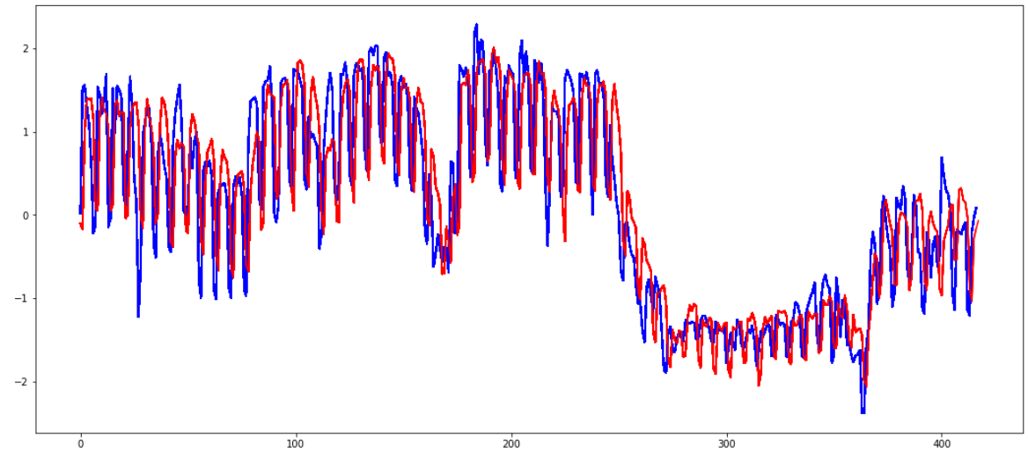
RESULTS
LSTM Model evaluation on training and validation set
X-axis (Horizontal Axis):
Represents the sequential order of days in the training set. Each point on the x-axis corresponds to a specific day.
Y-axis (Vertical Axis):
Represents the normalized energy consumption values on each corresponding day in the training set. The values on the y-axis indicate the normalized amount of energy consumed on each day.

Slide 14
RESULTS
Interpretation:
The blue line represents the actual (true) energy consumption values from the training set.
The red line represents the averaged predictions made by the LSTM model.
The plot visually compares how well the model's averaged predictions align with the actual energy consumption values in the training set.

Slide 15
Model Analysis
The LSTM model that was adapted is a primary consistent of one LSTM Layer of 50 neuron followed by 3 Dense layers. In addition, two separate input layers are used to separate between the temporal inputs which are the Energy consumption for each day of the 7 days input and the calendrical features used which are the day of the year, week of the year, and whether any of the dates we want to predict are Holidays.
Therefore, one the temporal information will be fed to the LSTM layer. The model’s output layer has 7 neuron each associated to one weekday we wish to predict.
The LSTM model proposed was trained and hyper tuned on the validation data. The model was trained for 300 epochs while using an early stopping monitor to prevent overfitting. A mean square error loss function was adapted to train the model. The final validation error reached by model was an MSE of 0.1482 while the average error over 10 run was 0.1466.

Slide 16
EXPECTED OUTCOMES
Reduced costs : Power utilities can save money by more efficiently matching generation to demand. This can be done by reducing the need to startup and shutdown expensive power plants, and by avoiding the need to purchase electricity from the wholesale market.
Improved Reliability: Load forecasting can help to prevent power outages by ensuring that there is enough generation capacity to meet demand. This is especially important during periods of high demand, such as hot summer days or cold winter nights.
Reduced emissions: Load forecasting can help to reduce greenhouse gas emissions by enabling power utilities to use more renewable energy sources, such as solar and wind power. This is because renewable energy sources are intermittent and unpredictable, so load forecasting is essential for ensuring that there is enough generation capacity to meet demand, even when renewable energy sources are not available.

Slide 17
FUTURE WORK TO BE DONE
Increase applicability :To improve generalizability, evaluate the forecasting model's performance by testing it on datasets from various geographical locations and time periods. This will help assess its adaptability under different conditions
Enhanced Model Architecture: Investigate and experiment with variations of LSTM architectures, such as stacked LSTMs or bidirectional LSTMs, to assess their impact on forecasting accuracy
Incorporation of External Factors: Explore the integration of external factors, such as weather patterns or economic indicators, to enhance the model's predictive capabilities and capture additional influencing variables.

Slide 18
REFERENCES
[1] Zhang, R., He, Y., & Wang, J. (2018). Short-term load forecasting using LSTM based on a two-stage strategy. In 2018 IEEE Power & Energy Society General Meeting (PESGM) (pp. 1-5).
[2] Huang, L., Lai, Z., Hu, W., & Peng, D. (2020). A hybrid model for short-term load forecasting based on LSTM and SVR. IEEE Access, 8, 180809-180819.
[3] H. Zheng, J. Yuan, and L. Chen, “Short-term load forecasting using EMDLSTM neural networks with a xgboost algorithm for feature importance evaluation,” Energies, vol. 10, no. 8, p. 1168, 2017,in press
[4] J. Moon, S. Jun, J. Park, Y.-H. Choi, and E. Hwang, “An electric load forecasting scheme for university campus buildings using artificial neural network and support vector regression,” KIPS Trans. Comput. Commun. Syst., vol. 5, no. 10, pp. 293–302, 2016, in press
[5] J. Moon, K.-H. Kim, Y. Kim, and E. Hwang, “A short-term electric load forecasting scheme using 2-stage predictive analytics,” in 2018 IEEE International Conference 2018, in press

Slide 19
THANK YOU

